Slide 1
Impact of Smoking on Diabetes Prediction Using Logistic Regression and Propensity Score Methods
Presenters: Nguyen Trang, Gomez Maria, Farooqui Numayr, Chithajhallu Sai Siva Deekshita

Slide 2
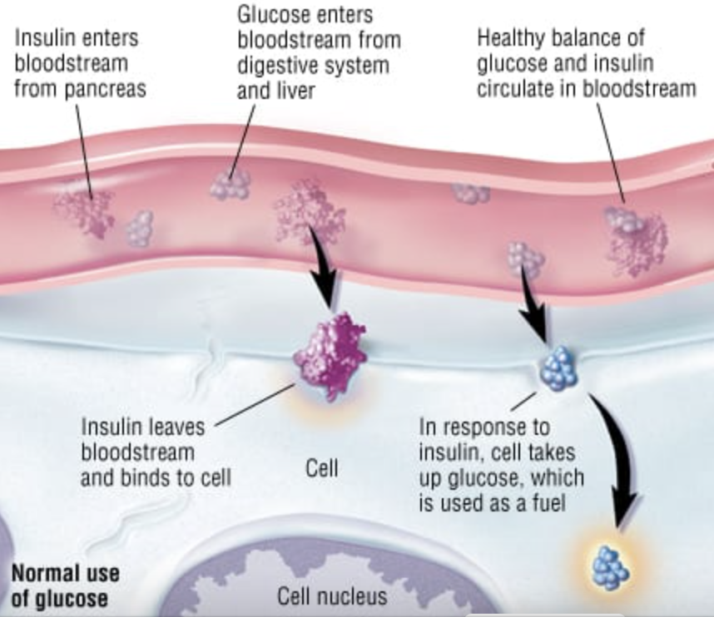
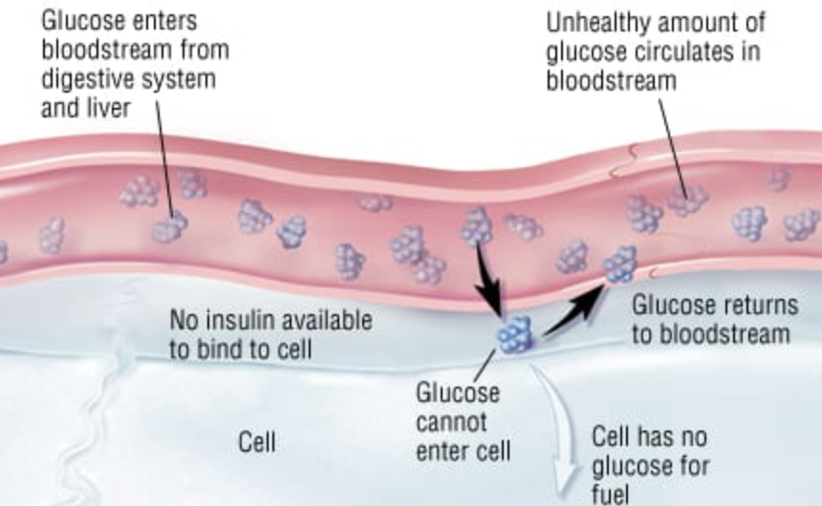
INTRODUCTION
BACKGROUND
Occur when glucose accumulates in the bloodstream due to the pancreas not producing enough insulin or the body's inability to utilize it effectively.
Figure 1. Healthy Balance of Glucose and Insulin vs. Unhealthy Glucose Levels in the Bloodstream [1]
RESEARCH QUESTION
Does smoking behavior influence the prediction of diabetes incidence, or are there other factors?
How do logistic regression and propensity score analysis contribute to understanding the relationship between predictors and the incidence of diabetes?
STUDY PURPOSE
To investigate the impact of smoking on the prediction of diabetes, particularly using logistic regression and propensity score analysis.

Slide 3
DATA DESCRIPTION
DATA SOURCE
Kaggle
Variable Name | Description | Data Type
gender | Gender of the individual (Female, Male) | Nominal Category
age | Age of the individual | Continuous
hypertension | Presence of hypertension (0 = no, 1 = yes) | Discrete
heart_disease | Presence of heart disease (0 = no, 1 = yes) | Discrete
smoking_history | History of smoking (never, current, no info) | Nominal Category
bmi | Body Mass Index (BMI) | Continuous
HbA1c_level | HbA1c level (average blood sugar over the past 3 months) | Continuous
blood_glucose_level | Blood glucose level | Continuous
diabetes | Diabetes status (0 = no, 1 = yes) | Discrete
DATA TYPE
100,000 patients
Table 1: Data Dictionary Table of 9 Contributors to Diabetes Prediction Analysis

Slide 4
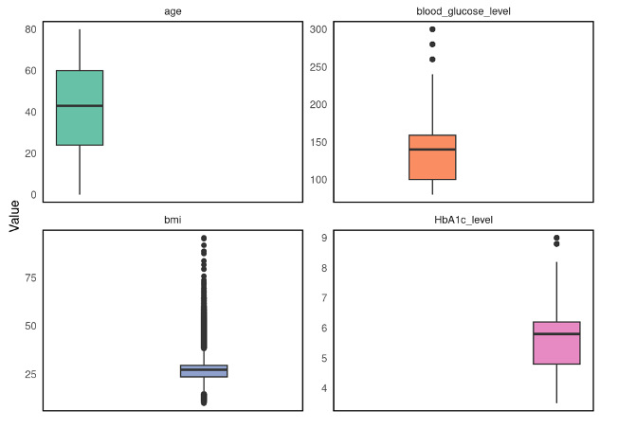
DATA CLEANING AND PREPROCESSING
HANDLING MISSING VALUES
OUTLIER TREATMENT AND DETECTION
Figure 1. Box Plots of Distribution 4 Continuous Variables of the Dataset
DIMENSIONALITY REDUCTION TECHNIQUES

Slide 5
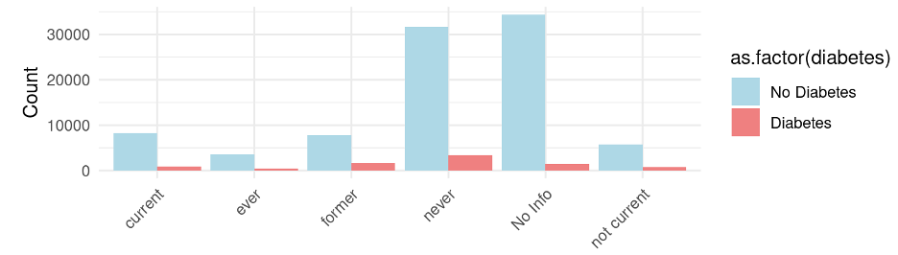
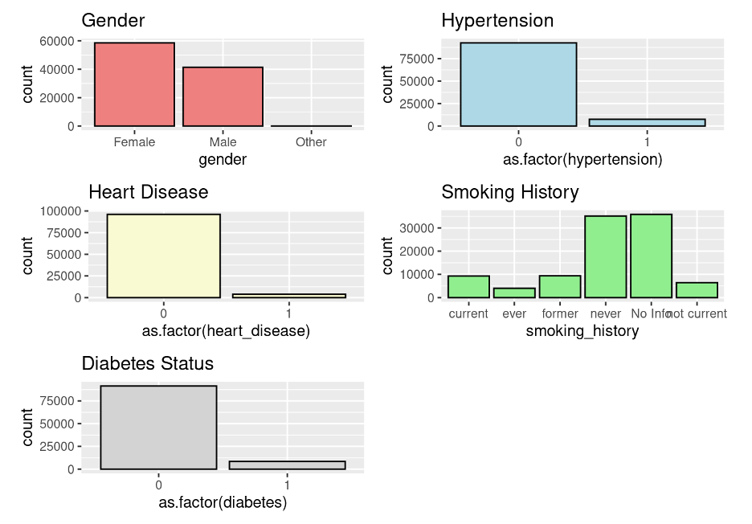
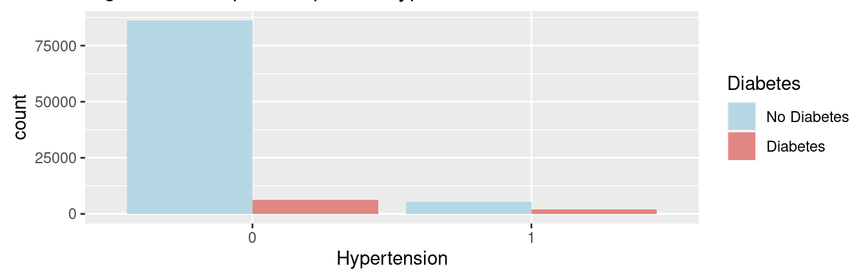
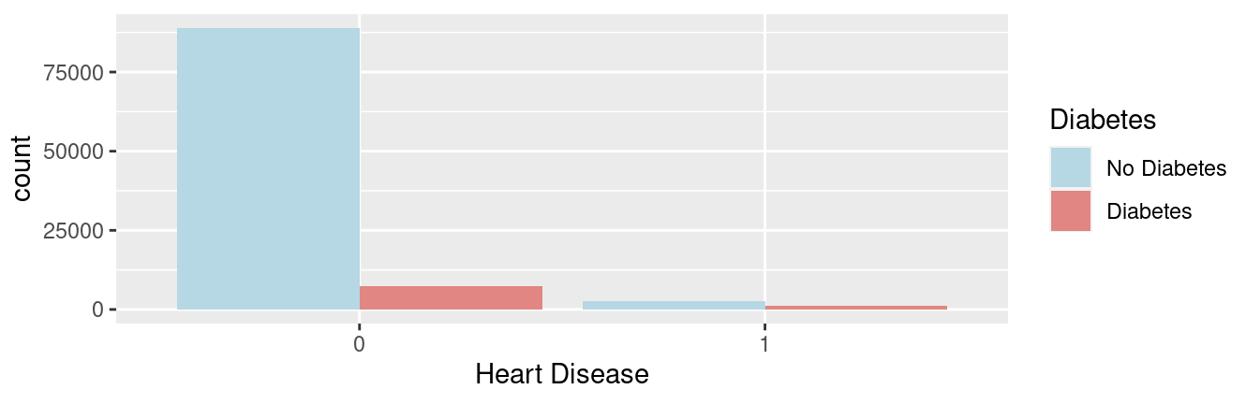
DATA VISUALIZATION
Figure 3. Barplot of smoking status, hypertension, heart disease, and diabetes status
Figure 2. Visualizing distributions of Categorical Variables

Slide 6
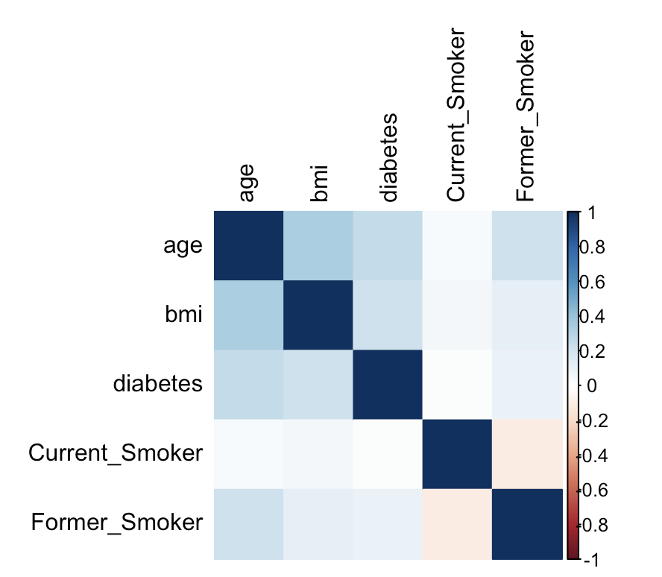
CORRELATION MATRIX
Figure 4. Heatmap Correlation between Predictors and Diabetes

Slide 7
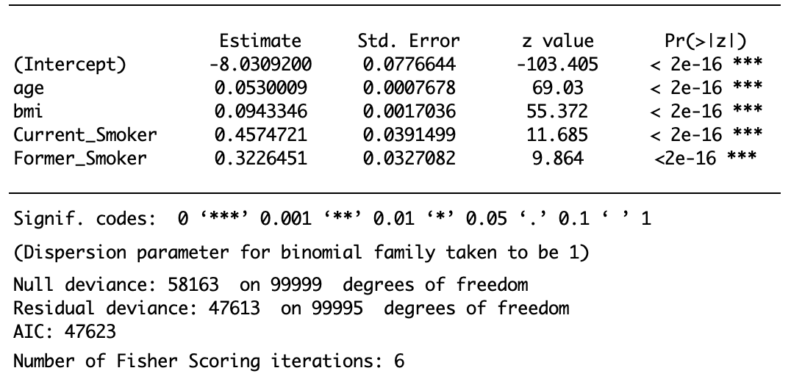
PREDICTING FACTORS ASSOCIATED WITH DIABETES: LOGISTIC REGRESSION ANALYSIS
HYPOTHESIS TESTING
Null Hypothesis: There is no significant relationship between the predictor variables and the probability of having diabetes.
Alternative Hypothesis: There is a significant relationship between at least one of the predictor variables and the probability of having diabetes.
RESULTS
Table 2. Summary of logistic regression model for diabetes incidence
Current smoking and former smoking status are the most significant and positive impacts associated with the probability of having diabetes. As the presence of current and former smoking increases, the probability of diabetes also increases.

Slide 8
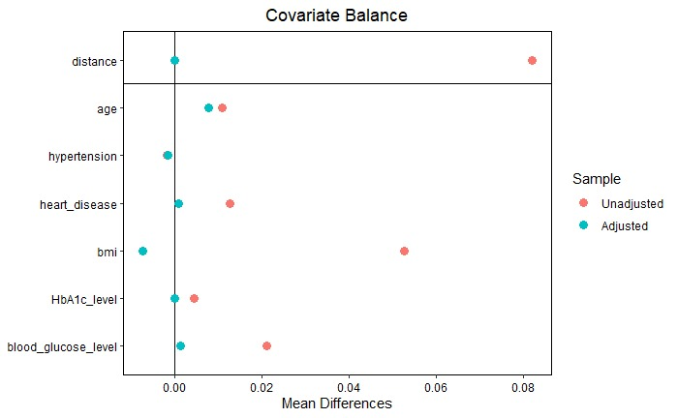
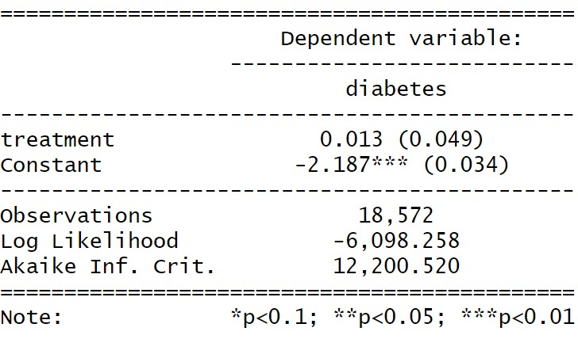
PREDICTING DIABETES USING PROPENSITY SCORE METHOD
TREATMENT VARIABLE
Smoking Status: 1 = current smoker and 0 = never smoker
PURPOSE
To match current smokers with never-smokers based on their propensity scores (i.e., the predicted probability of being a current smoker based on observed covariates). Standard covariates include age, hypertension, heart disease, BMI, etc.
Figure 5. Covariate Balance
Table 5. Regression Analysis Results

Slide 9
CONCLUSION
Smoking: The results from the logistic regression suggest that, once we control for other factors like age, hypertension, heart disease, BMI, HbA1c level, and blood glucose level, being a current smoker does not have a statistically significant effect on the likelihood of having diabetes compared to those who have never smoked.
Further Research: While our current data suggests that being a smoker does not have a statistically significant effect on the likelihood of having diabetes compared to those who have never smoked, it's crucial to consider the broader context. Smoking has been linked to several mechanisms that increase the risk of developing type 2 diabetes, such as insulin resistance, chronic inflammation, changes in fat distribution, direct effects on the pancreas, cellular disruptions, increased belly fat, lifestyle factors, and hormonal disruptions. Each of these mechanisms offers a pathway through which smoking can influence diabetes risk.

Slide 10
REFERENCES
Patient Basics: Type 1 Diabetes Mellitus. 2 Minute Medicine. [accessed 2023 Oct 9]; https://www.2minutemedicine.com/patient-basics-type-1-diabetes-mellitus.
Gray N, Picone G, Sloan F, Yashkin A. Relation between BMI and diabetes mellitus and its complications among US older adults. South Med J. [accessed 2023 Oct 9];108(1):29-36. https://www.ncbi.nlm.nih.gov/pmc/articles/PMC4457375.
Eschbacher S, Schoen T, Clair C, Schillinger P, Schönenberger S, Risch M, Risch L, Conen D. Association of smoking and nicotine dependence with pre-diabetes in young and healthy adults. Swiss Med Wkly. [accessed 2023 Oct 9];144:w14019. https://www.ncbi.nlm.nih.gov/pubmed/25295968.
Rahman, M. A., Zaman, M. M., & Rahman, M. Prevalence and risk factors of type 2 diabetes in Bangladesh: A systematic review. Scientific Reports. [accessed 2023 Oct 9];10:1-10. https://www.nature.com/articles/s41598-020-66084-9.
Tsimihodimos V, Gonzalez-Villalpando C, Meigs JB, Ferrannini E. Hypertension and Diabetes Mellitus: Co-prediction and Time Trajectories. Hypertension. [accessed 2023 Oct 9];71(3):422-428. https://www.ncbi.nlm.nih.gov/pmc/articles/PMC5877818.

